Slide 1
LECTURE NOTES 1
MATHEMATICAL REVIEWS

Slide 2
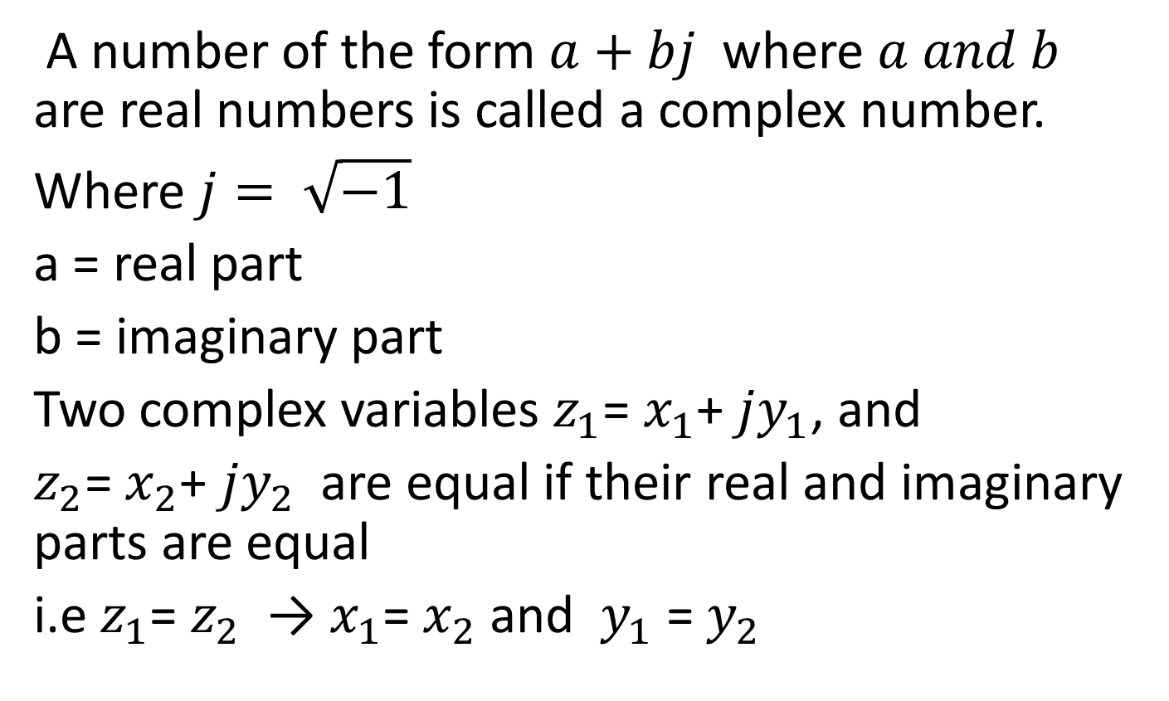
COMPLEX VARIABLES
A number of the form $a+bj$ where $a and b$ are real numbers is called a complex number.
Where $j= \sqrt{−1}$
a = real part
b = imaginary part
Two complex variables $z_{1}$= $x_{1}$+ $jy_{1}$, and
$z_{2}$= $x_{2}$+ $jy_{2}$ are equal if their real and imaginary parts are equal
i.e $z_{1}$= $z_{2}$ → $x_{1}$= $x_{2}$ and $y_{1}$ = $y_{2}$

Slide 3
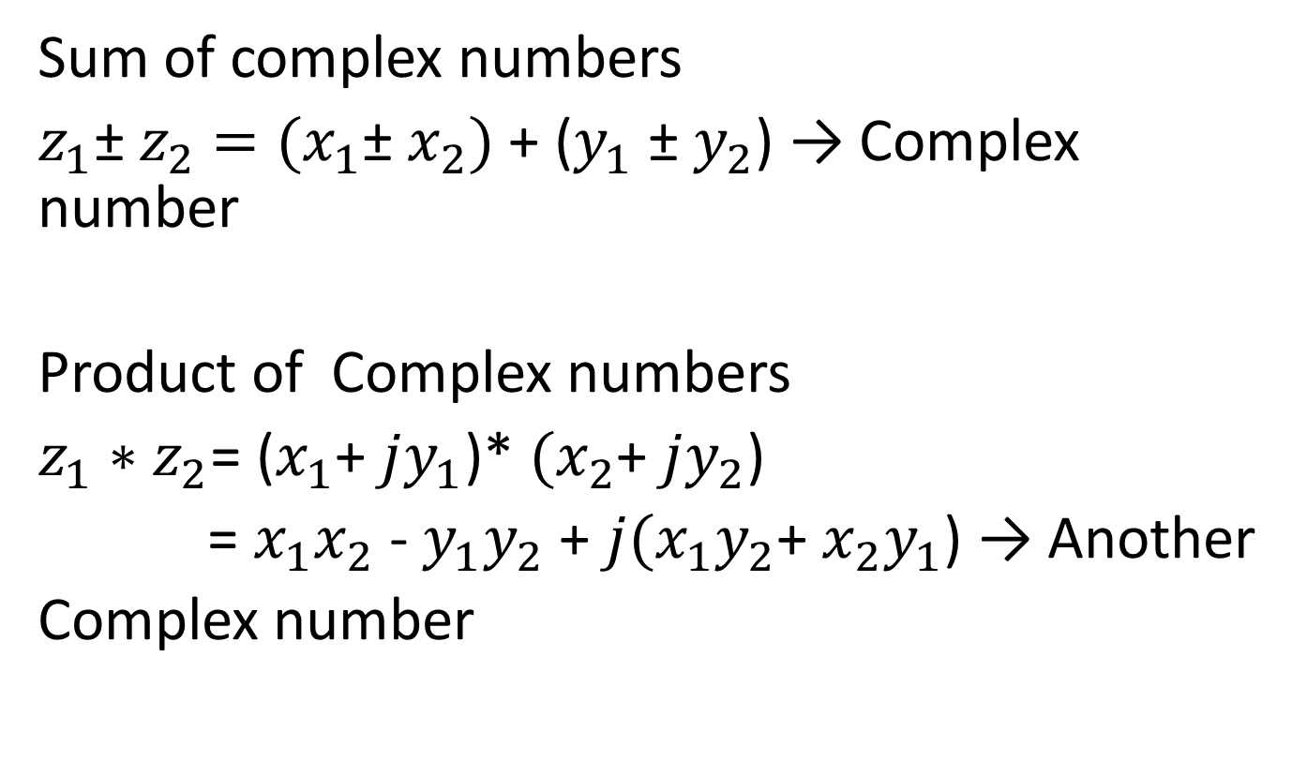
Sum of complex numbers
$z_{1}$± $z_{2}$ $=(x_{1}$± $x_{2})$ + ($y_{1}$ ± $y_{2}$) → Complex number
Product of Complex numbers
$z_{1}∗$ $z_{2}$= ($x_{1}$+ $jy_{1}$)* $(x_{2}$+ $jy_{2}$)
= $x_{1}x_{2}$ - $y_{1}y_{2}$ + $j{(x_{1}y}_{2}$+ ${x_{2}y}_{1}$) → Another
Complex number

Slide 4
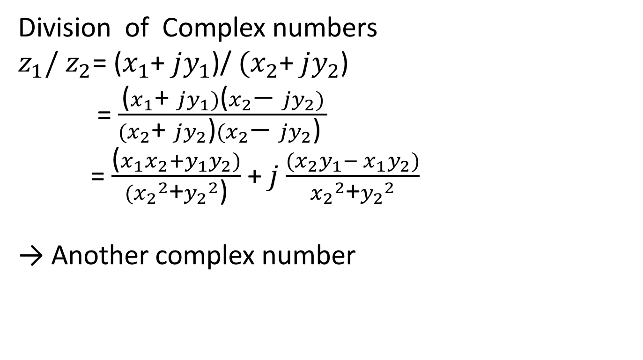
Division of Complex numbers
$z_{1}/$ $z_{2}$= ($x_{1}$+ $jy_{1}$)/ $(x_{2}$+ $jy_{2}$)
= $\frac{\text{(}x_{1}\text{+ }jy_{1})\text{(}x_{2}\text{−} jy_{2})}{(x_{2}\text{+ }jy_{2}\text{)}(x_{2}\text{−} jy_{2}\text{) }}$
= $\frac{\text{(}x_{1}x_{2}+y_{1}y_{2})}{({x_{2}}^{2}\text{+}{y_{2}}^{2}\text{)}}$ + $j$ $\frac{{(x}_{2}y_{1}− x_{1}y_{2})}{{x_{2}}^{2}\text{+}{y_{2}}^{2}}$
→ Another complex number

Slide 5
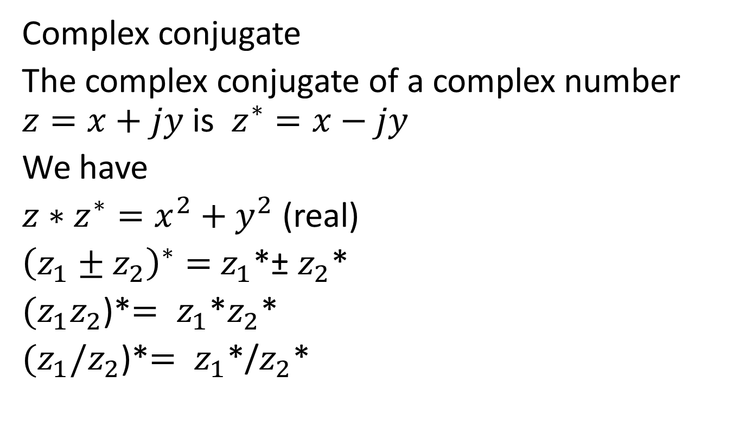
Complex conjugate
The complex conjugate of a complex number $z=x+jy$ is $z^{∗}=x−jy$
We have
$z∗z^{∗}=x^{2}+y^{2}$ (real)
${\left(z_{1}±z_{2}\right)}^{∗}=$ $z_{1}$*± $z_{2}$*
$(z_{1}z_{2}$)*$= z_{1}$*$z_{2}$*
$(z_{1}{/z}_{2}$)*$= z_{1}$*/$z_{2}$*

Slide 6
REPRESENTATION OF COMPLEX NUMBERS AS VECTORS IN A 2-D PLANE
Im. axis
z=x+jy
x
Real axis
Z*= x-jy

Slide 7
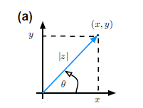

Slide 8
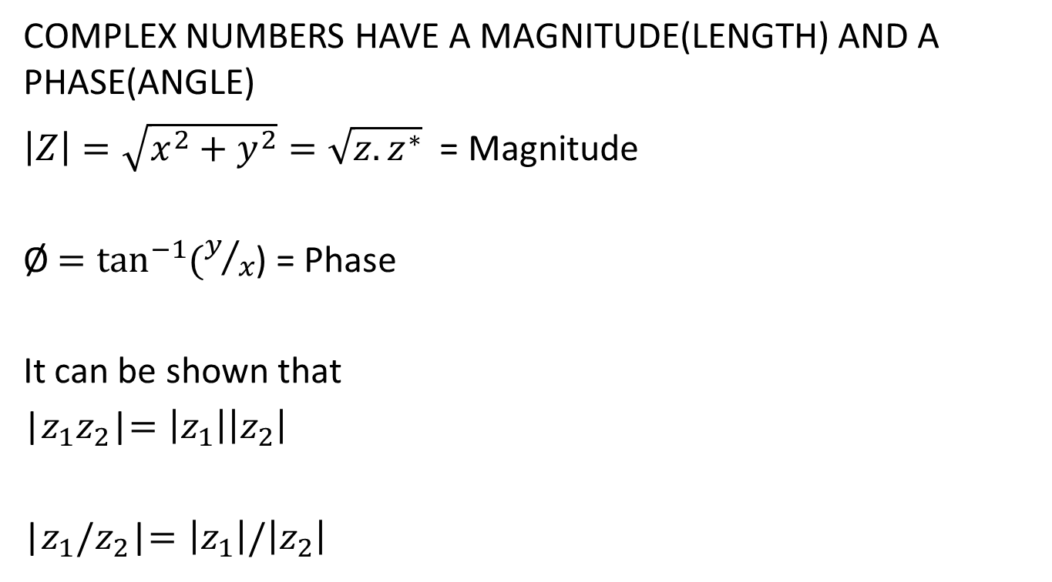
COMPLEX NUMBERS HAVE A MAGNITUDE(LENGTH) AND A PHASE(ANGLE)
$\left|Z\right|=\sqrt{x^{2}+y^{2}}=\sqrt{z{.z}^{∗}}$ = Magnitude
Ø $=\tan^{−1}{(y/x}$) = Phase
It can be shown that
|$z_{1}z_{2}$|$=\left|z_{1}\right|\left|z_{2}\right|$
|$z_{1}{/z}_{2}$|$=\left|z_{1}\right|/\left|z_{2}\right|$

Slide 9
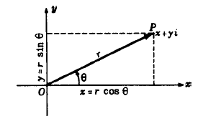
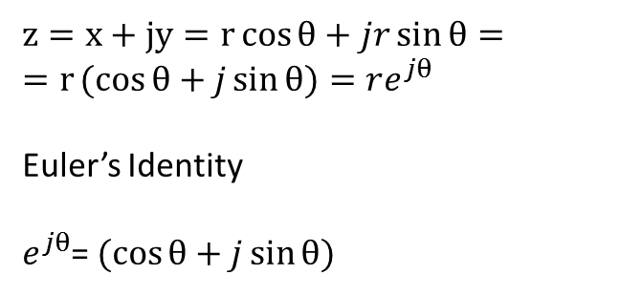
POLAR FORM REPRESENTATION OF COMPLEX NUMBERS
$z=x+jy=r\cos{θ+jr\sin{θ=}}$ $=r(cos{θ+j\sin{θ)=re^{jθ}}}$
Euler’s Identity
$e^{jθ}$= $(cos{θ+j\sin{θ)}}$

Slide 10
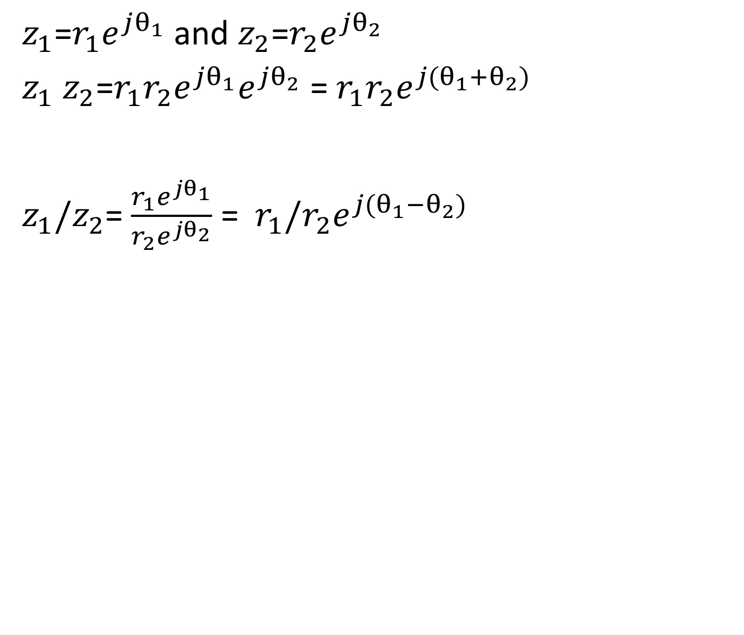
MULTIPLICATION AND DIVISION OF COMPLEX VARIABLES IS MORE EASILY DONE IN POLAR FORM
$z_{1}$=$r_{1}e^{jθ_{1}}$ and $z_{2}$=$r_{2}e^{jθ_{2}}$
$z_{1}$ $z_{2}$=$r_{1}{r_{2}e}^{jθ_{1}}e^{jθ_{2}}$ = $r_{1}{r_{2}e}^{j(θ_{1}+θ_{2})}$
$z_{1}/z_{2}$= $\frac{r_{1}e^{jθ_{1}}}{r_{2}e^{jθ_{2}}}$ = $r_{1}{{/r}_{2}e}^{j(θ_{1}−θ_{2})}$

Slide 11
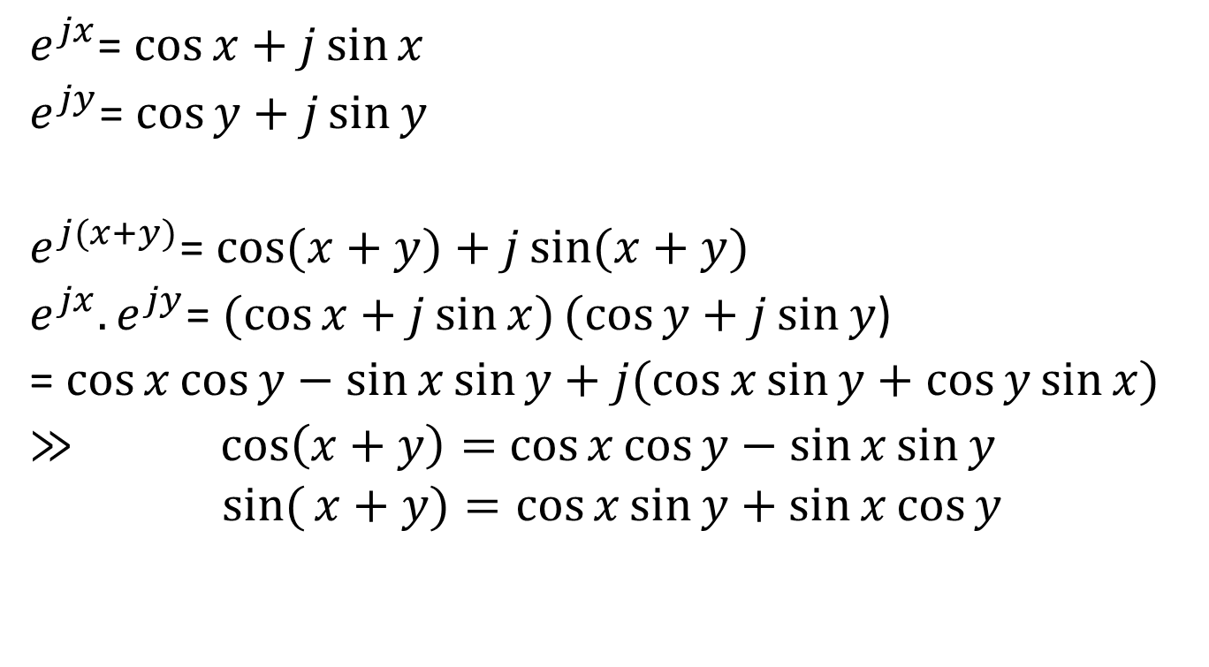
IMPORTANT TRIGONOMETRIC IDENTITIES
$e^{jx}$= $\cos{x+j\sin{x}}$
$e^{jy}$= $\cos{y+j\sin{y}}$
$e^{j(x+y)}$= $\cos{(x+y)+j\sin{(x+y)}}$
$e^{jx}.e^{jy}$= $(cos{x+j\sin{x})(cos{y+j\sin{y}}}$)
= $\cos{x}\cos{y−\sin{x\sin{y+j(\cos{x\sin{y+\cos{y\sin{x)}}}}}}}$
$≫ \cos\left(x+y\right)=$ $\cos{x\cos{y−\sin{x\sin{y}}}}$
$$sin({x+y)=\cos{x\sin{y+\sin{x\cos{y}}}}}$$

Slide 12
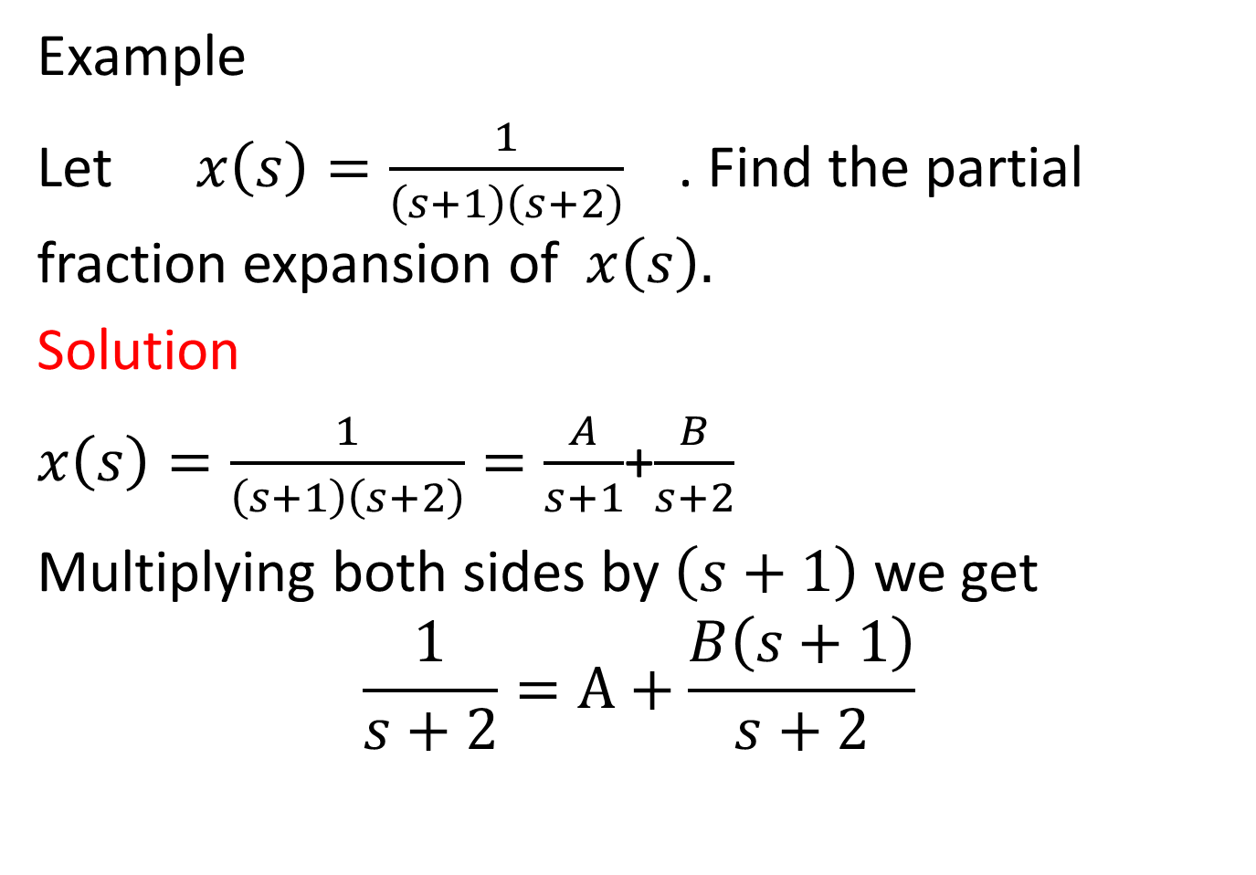
PARTIAL FRACTIONS
Example
Let $x\left(s\right)=\frac{1}{\left(s+1\right)\left(s+2\right)}$ . Find the partial fraction expansion of $x\left(s\right).$
Solution
$x\left(s\right)=\frac{1}{\left(s+1\right)\left(s+2\right)}=\frac{A}{s+1}$+$\frac{B}{s+2}$
Multiplying both sides by $\left(s+1\right)$ we get
$$\frac{1}{s+2}=A+\frac{B\left(s+1\right)}{s+2}$$

Slide 13
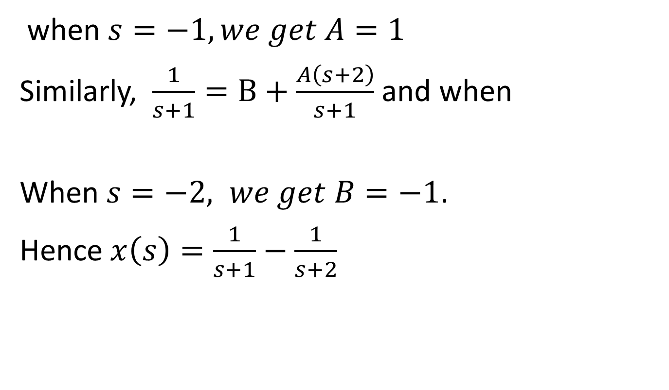
when $s=−1, we get A=1$
Similarly, $\frac{1}{s+1}=B+\frac{A\left(s+2\right)}{s+1}$ and when
When $s=−2, we get B=−1$.
Hence $x\left(s\right)=\frac{1}{s+1}−\frac{1}{s+2}$

Slide 14

TRY
Express $x\left(s\right)=\frac{1}{\left(s+1\right)\left(s+3\right)}$ into partial fractions.

Slide 15

GEOMETRIC SERIES
Prove that
$$\sum_{n=0}^{N−1}{α^{n}} =\left\{\begin{aligned}&\frac{1−α^{n}}{1−α}, α≠1 \\ &N, α=1\end{aligned}\right.$$

Slide 16
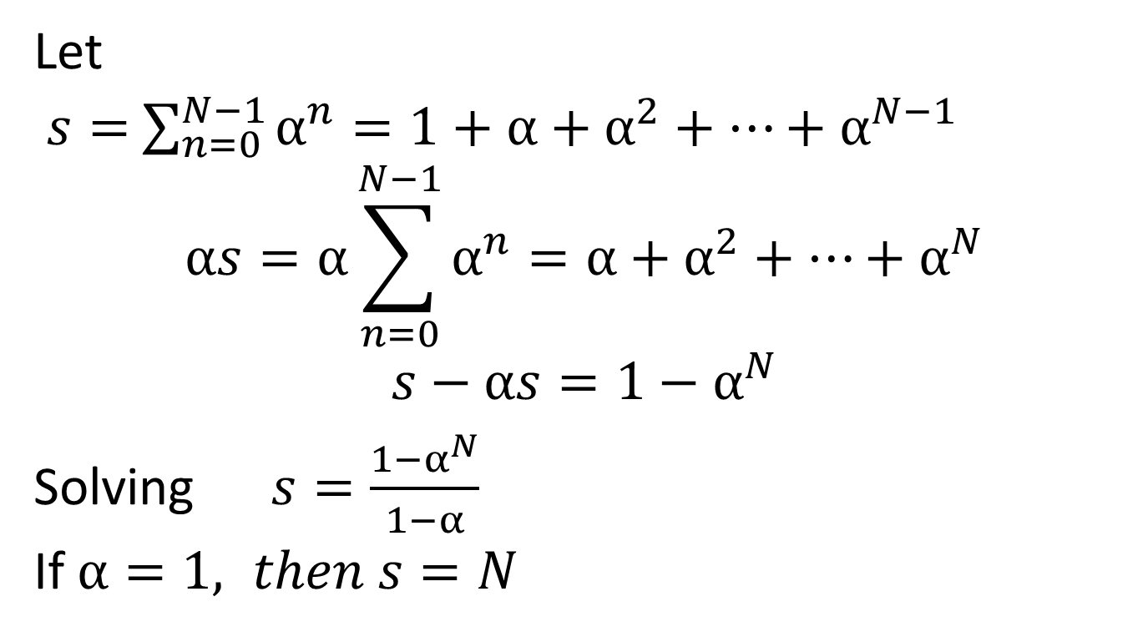
Let
$s=$ $\sum_{n=0}^{N−1}{α^{n}}=1+α+α^{2}+…+α^{N−1}$
$$αs=α\sum_{n=0}^{N−1}{α^{n}}=α+α^{2}+…+α^{N}$$
$$s−αs=1−α^{N}$$
Solving $s=\frac{1−α^{N}}{1−α}$
If $α=1, then s=N$

Slide 17
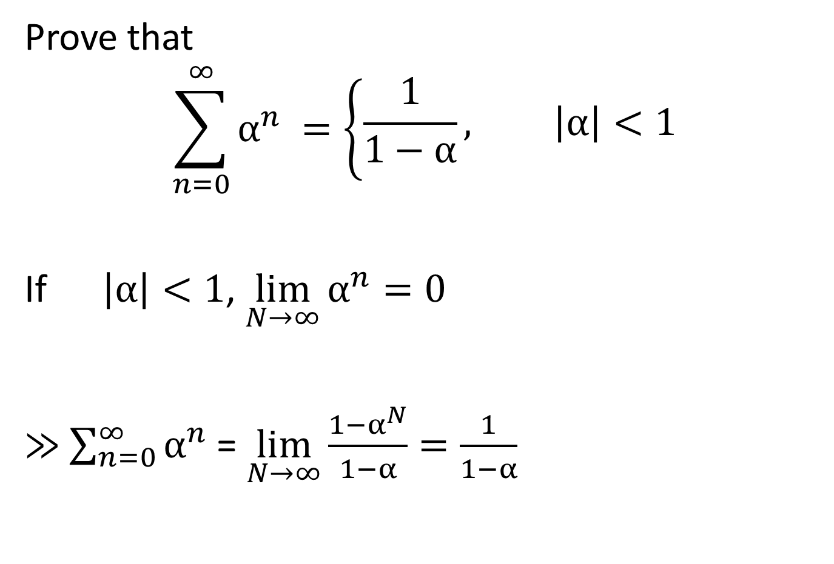
Prove that
$$\sum_{n=0}^{∞}{α^{n}} =\left\{\begin{aligned}&\frac{1}{1−α}, \left|α\right|<1 \\ & \end{aligned}\right.$$
If $\left|α\right|<1$, $\lim_{N→∞}{α^{n}=0}$
$≫$ $\sum_{n=0}^{∞}{α^{n}}$ = $\lim_{N→∞}{\frac{1−α^{N}}{1−α}}=\frac{1}{1−α}$

Slide 18
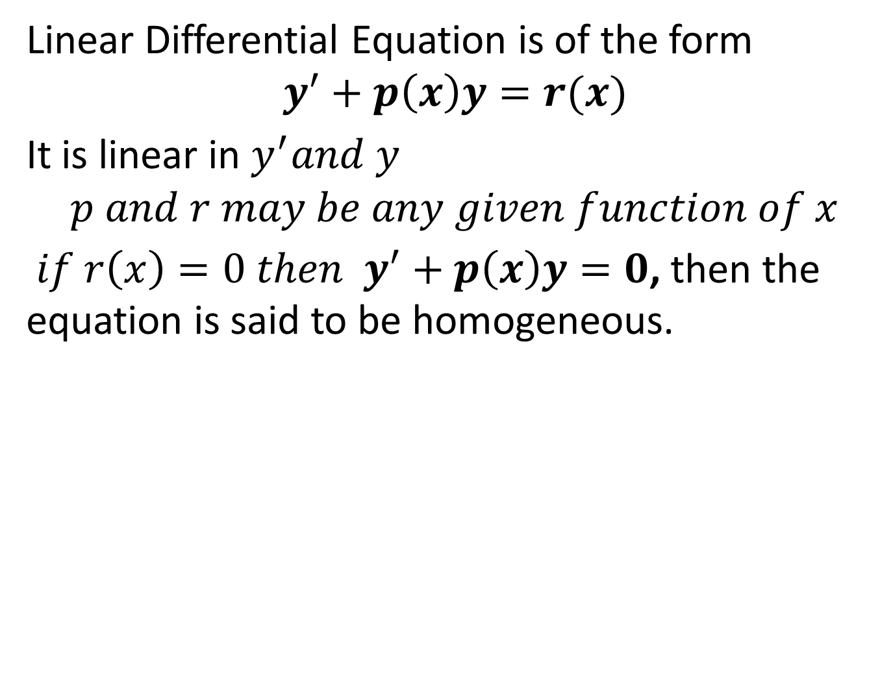
LINEAR DIFFERENTIAL EQUATIONS
Linear Differential Equation is of the form
$$y^{′}+p\left(x\right)y=r(x)$$
It is linear in $y^{′}and y$
$$p and r may be any given function of x$$
$if r\left(x\right)=0 then$ $y^{′}+p\left(x\right)y=0$, then the equation is said to be homogeneous.

Slide 19
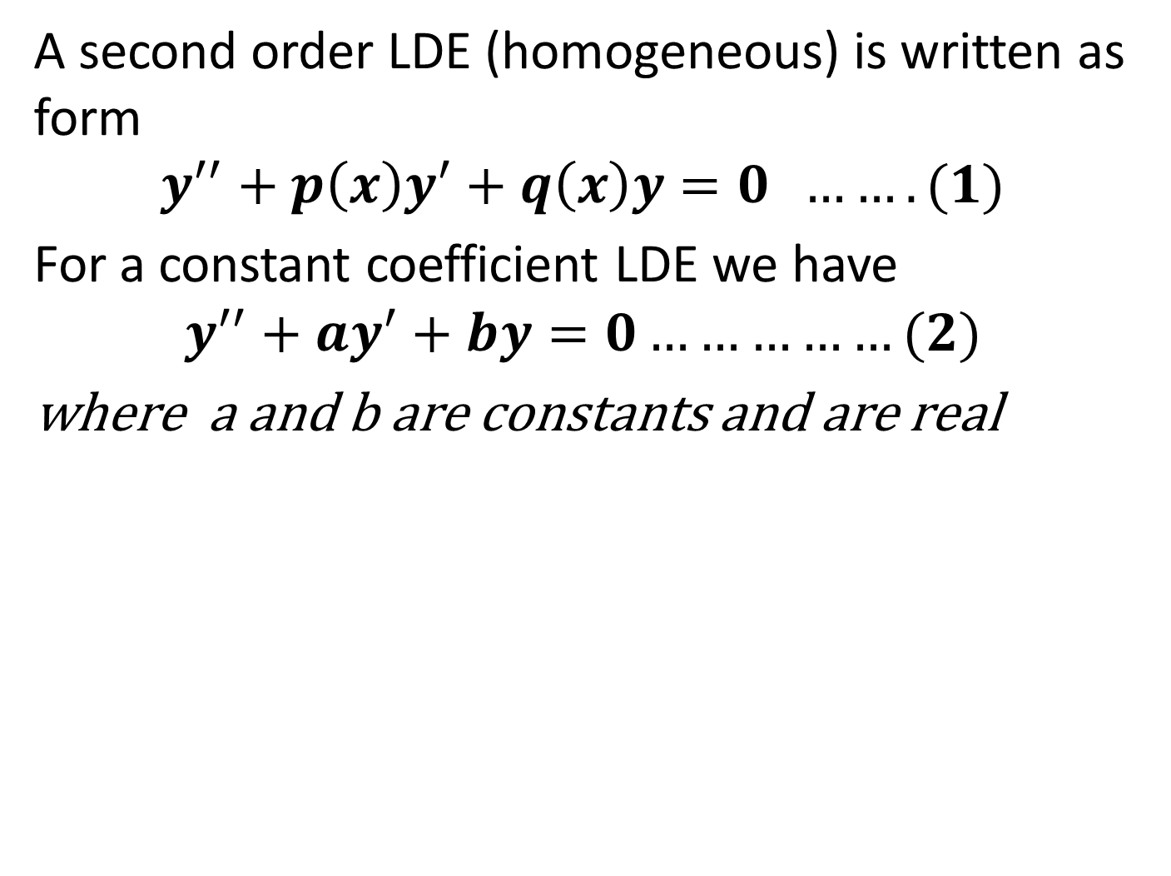
LINEAR DIFFERENTIAL EQUATIONS
A second order LDE (homogeneous) is written as form
$$y^{′′}+p\left(x\right)y^{′}+q\left(x\right)y=0 …….(1)$$
For a constant coefficient LDE we have
$$y^{′′}+ay^{′}+by=0……………(2)$$
where a and b are constants and are real

Slide 20
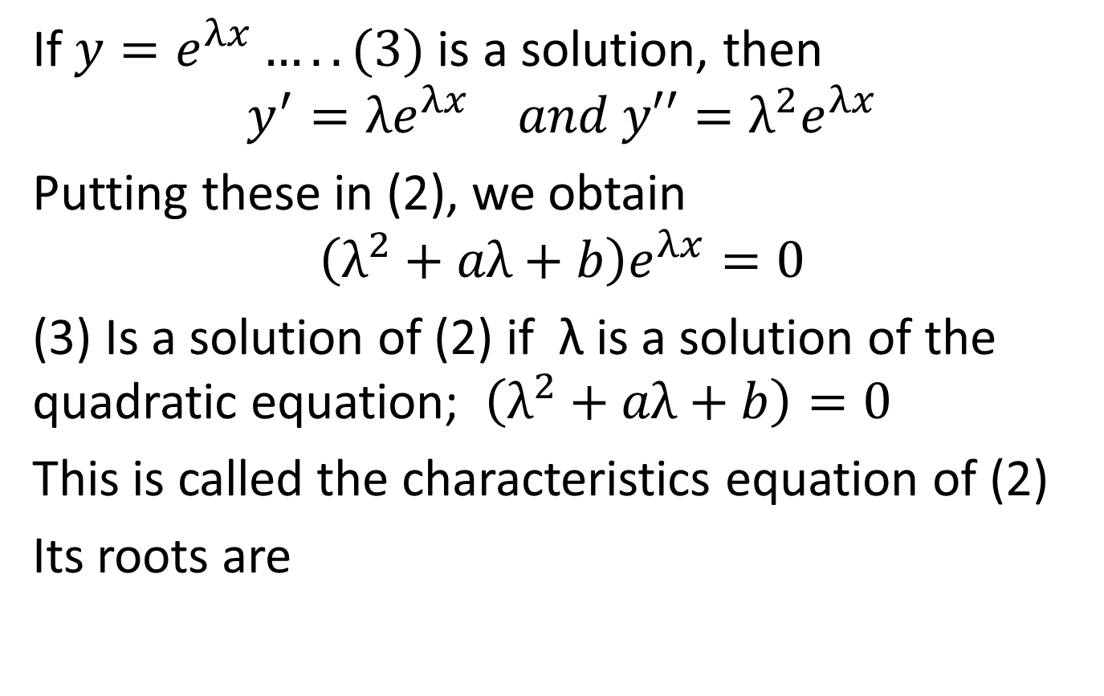
Solution of LDE
If $y=e^{λx}…..(3)$ is a solution, then
$$y^{′}={λe}^{λx} and y′′=λ^{2}e^{λx}$$
Putting these in (2), we obtain
$$\left(λ^{2}+aλ+b\right)e^{λx}=0$$
(3) Is a solution of (2) if λ is a solution of the quadratic equation; $\left(λ^{2}+aλ+b\right)=0$
This is called the characteristics equation of (2)
Its roots are

Slide 21
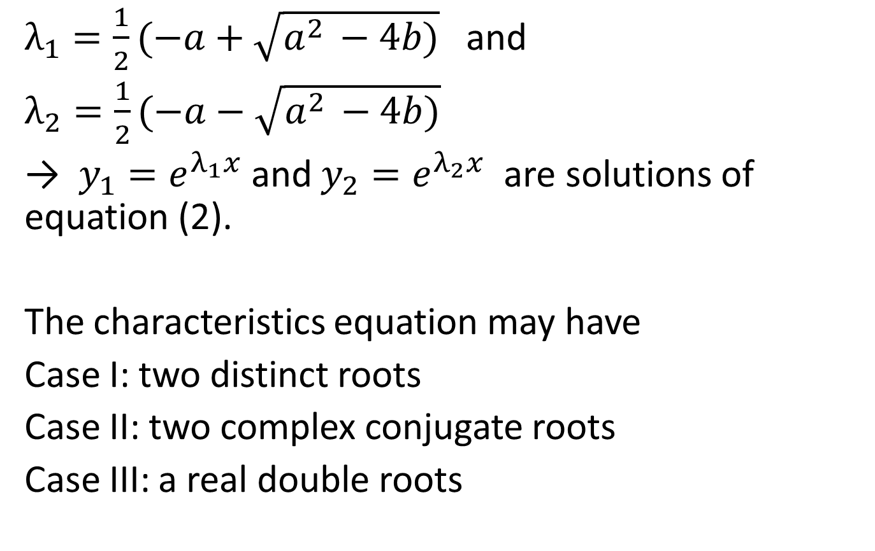
$λ_{1}=\frac{1}{2}(−a+\sqrt{a^{2 }−4b)}$ and
$λ_{2}=\frac{1}{2}(−a−\sqrt{a^{2 }−4b)}$
→ $y_{1}{=e}^{λ_{1}x}$ and $y_{2}{=e}^{λ_{2}x}$ are solutions of equation (2).
The characteristics equation may have
Case I: two distinct roots
Case II: two complex conjugate roots
Case III: a real double roots

Slide 22
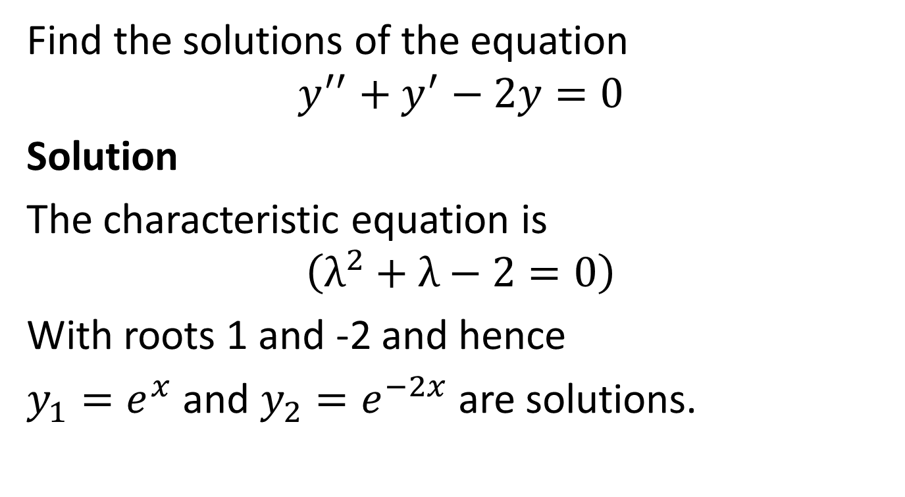
Example
Find the solutions of the equation
$$y^{′′}+y^{′}−2y=0$$
Solution
The characteristic equation is
$$\left(λ^{2}+λ−2=0\right)$$
With roots 1 and -2 and hence
$y_{1}{=e}^{x}$ and $y_{2}{=e}^{−2x}$ are solutions.

